Slide 1

Capstone Project – The Battle of Neighborhoods
Finding a Better Place in Scarborough, Toronto

Slide 2
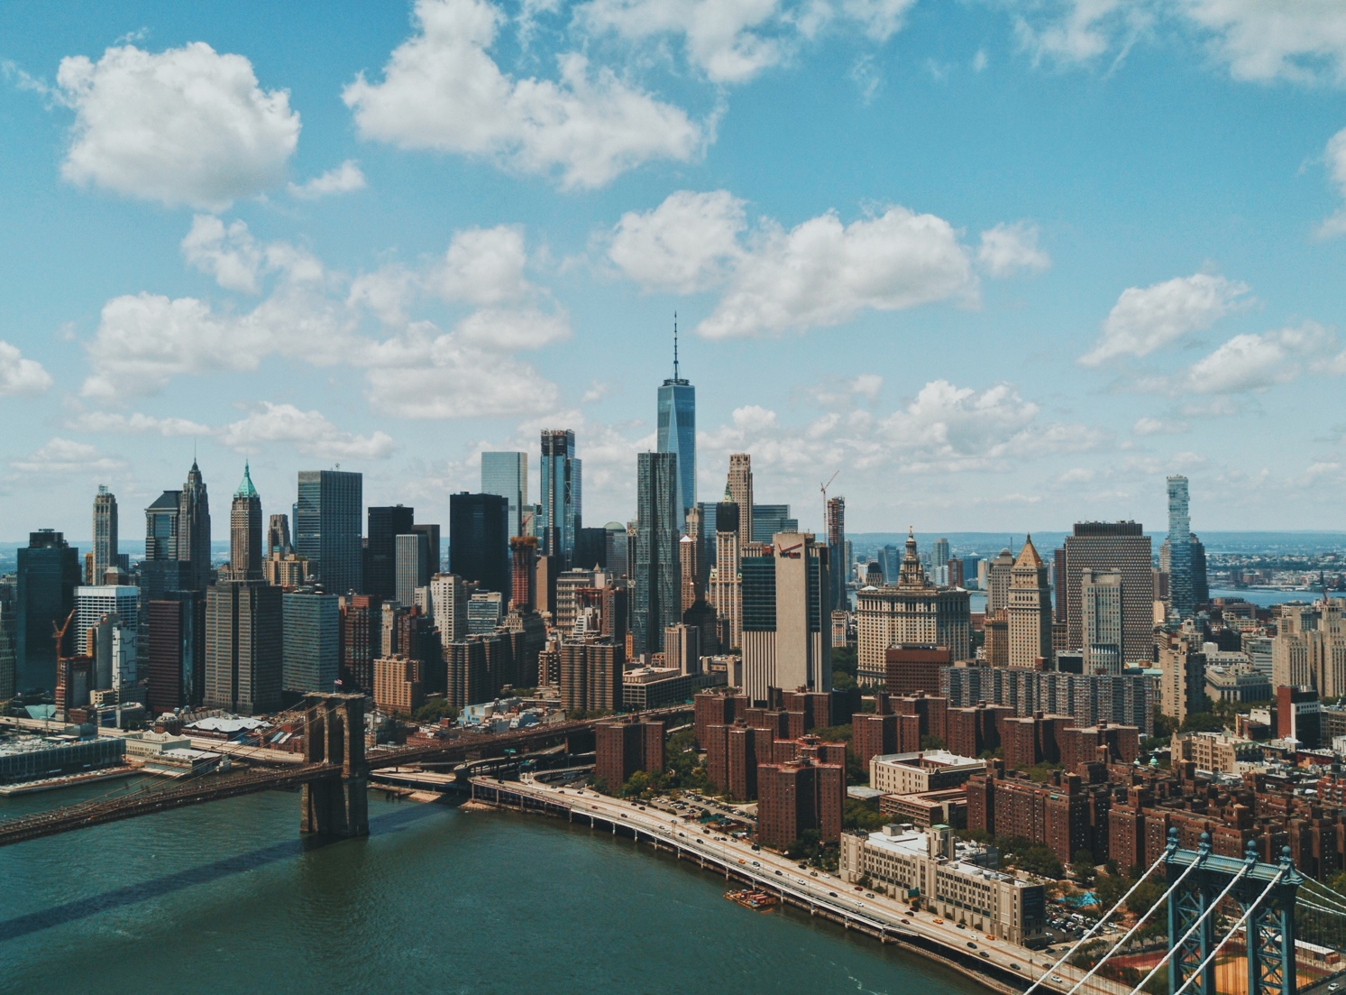
Introduction
The purpose of this Capstone Project is to help people in exploring better facilities around their neighborhood. It will help people making smart and efficient decision on selecting great neighborhood out of numbers of other neighborhoods in Scarborough, Toranto.

Slide 3

Analysis done in this project
This Capstone Project aim to create an analysis of features for a people migrating to Scarborough to search a best neighborhood as a comparative analysis between neighborhoods. The features include median housing price and better school according to ratings, crime rates of that particular area, road connectivity, weather conditions, good management for emergency, water resources both freash and waste water and excrement conveyed in sewers and recreational facilities.
It will help people to get awareness of the area and neighborhood before moving to a new city, state, country or place for their work or to start a new fresh life.

Slide 4

Data section
Data Link: https://en.wikipedia.org/wiki/List_of_postal_codes_of_Canada:_M
Will use Scarborough dataset which we scrapped from wikipedia on Week 3. Dataset consisting of latitude and longitude, zip codes.
Foursquare API Data:
We will need data about different venues in different neighborhoods of that specific borough. In order to gain that information we will use “Foursquare” locational information.

Slide 5

Data retrieved
1. Neighborhood
2. Neighborhood Latitude
3. Neighborhood Longitude
4. Venue
5. Name of the venue e.g. the name of a store or restaurant
6. Venue Latitude
7. Venue Longitude
8. Venue Category
The data retrieved from Foursquare contained information of venues within a specified distance of the longitude and latitude of the postcodes. The information obtained per venue as follows:

Slide 6
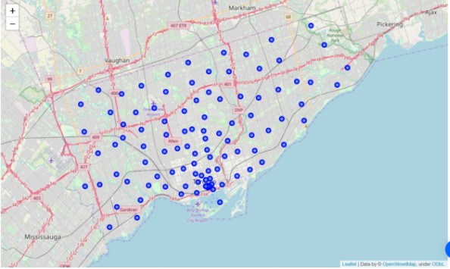
Map of scarborough

Slide 7

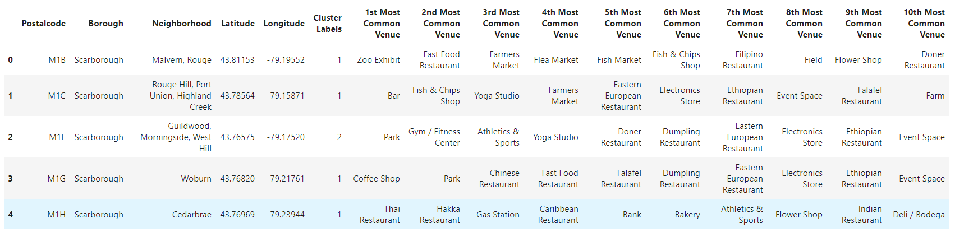
Methodology section Clustering Approach: To compare the similarities of two cities, we decided to explore neighborhoods, segment them, and group them into clusters to find similar neighborhoods in a big city like New York and Toronto. To be able to do that, we need to cluster data which is a form of unsupervised machine learning: k-means clustering algorithm.
Using K-Means Clustering Approach | Most Common Venue

Slide 8
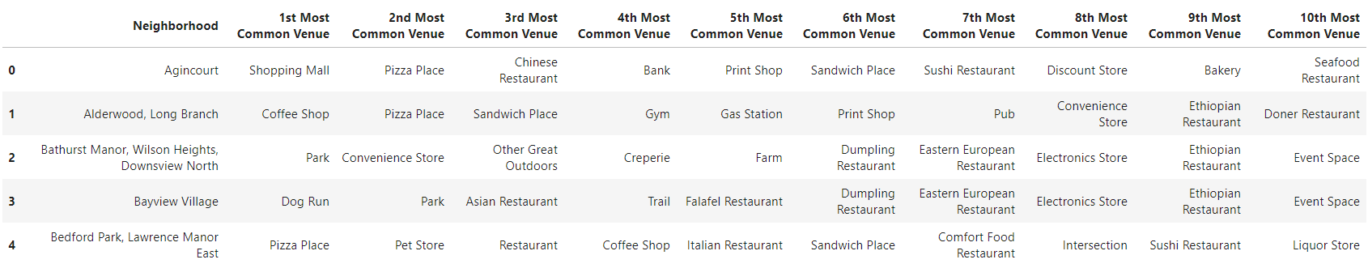
Most Common Venues near Neighborhood | Using Clustering

Slide 9
Result section Map of clusters in scarborough

Slide 10
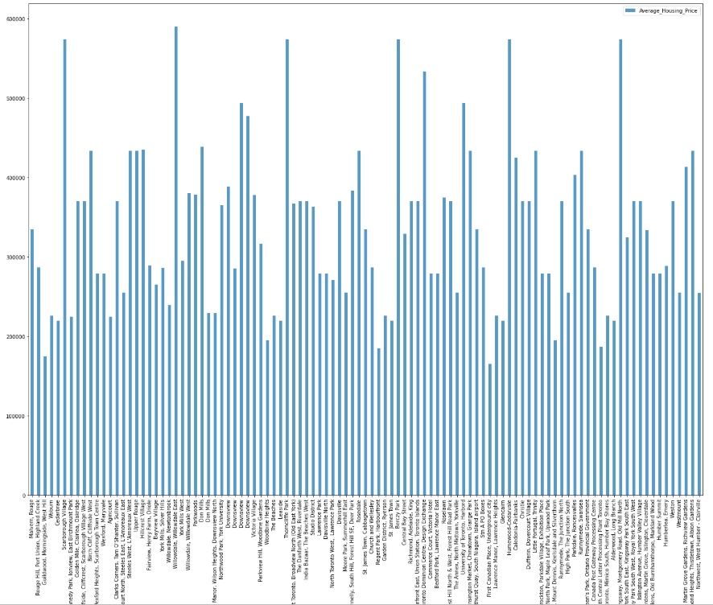
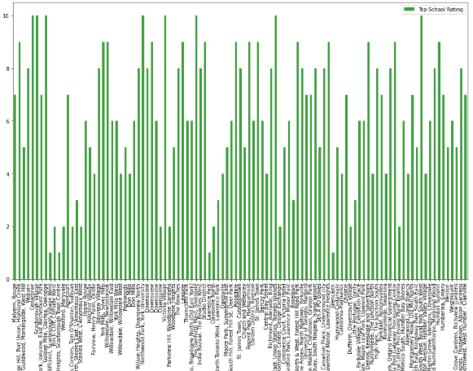
School Ratings by Clusters in Scarborough
Average Housing Price by Clusters in Scarborough

Slide 11
Discussion section
Problem Which Tried to Solve:
The major purpose of this project, is to suggest a better neighborhood in a new city for the person who are shiffting there. Social presence in society in terms of like minded people. Connectivity to the airport, bus stand, city center, markets and other daily needs things nearby.
Sorted list of house in terms of housing prices in a ascending or descending order
Sorted list of schools in terms of location, fees, rating and reviews

Slide 12
conclusion
In this Capstone project, using k-means cluster algorithm I separated the neighborhood into 10(Ten) different clusters and for 103 different lattitude and logitude from dataset, which have very-similar neighborhoods around them. Using the charts above results presented to a particular neighborhood based on average house prices and school rating have been made.

Slide 13

Thank you!
https://gist.github.com/Shruthi-Vasanth/abff515ef6e26f58653ed1d9e7809c6c

